Slide 1

Agile 3-DB Systel
User Story
Neeraj Vohra

Slide 2
Story Points in Agile
The development of software, using other people’s money (OPM) means - or should mean - that those providing the money have an expectation to know how much money , along with how well you be done spending that money, and provide me the Measurable Value (Effectiveness and Performance) I bought with that money?
A story point is a metric used in agile project management and development to estimate the difficulty of implementing a given user story, which is an abstract measure of effort required to implement it. In simple terms, a story point is a number that tells the team about the difficulty level of the story. Difficulty could be related to complexities, risks, and efforts involved.
Story point estimation, a kind of relative estimation, is typically performed at the Product Backlog Grooming Sessions and the Product Backlog is evaluated by the team who responsible for the actual development and testing work.

Slide 3
Are Story points just similar than hours?
If story points and hours are similar, why do we then even need story points? You could easily calculate the hours from any given number of story points. And if that is possible, why do we even have story points in the first place, if they can be mapped to hours easily? Then we can just estimate with hours instead, without introducing another layer (of story points) on top. This just confuses developers and stakeholders, right?
Well, let me give you the reason why we need story points for estimations.

Slide 4
Each developer has a different set of skills and experience
It is quite easy to explain that you have different persons in a team and each person has a certain set of skills and a certain level of experience. We are working in a team, you can think of a member, who has great skills and is fast, while another member is quite new, and it takes him/her some time to complete tasks.
For example, let´s assume a developer, we call him Fastian, is able to finish a certain task in 2 hours, while another developer, let´s call him Slowden, will spend 8 hours to finish the same task. That´s simply because of the fact, that Fastian is faster, he has more skills and way more experience than our young, slow guy Slowden.
So how would you estimate such a task in hours? Is it 2 hours, because you assume that Fastian should pick it up, as he will be faster? Or you estimate 8 hours, because you want to do a pessimistic estimation to make sure the sprint will be finished. Or do you estimate the task with 5 hours, the average value?
It is quite hard to decide and you won´t get it right, unless you know exactly who will pick up that task. But forecasting for a whole sprint, who is going to work on which tasks is (under usual circumstances) impossible.

Slide 5
A story point has a different meaning for each developer
That´s exactly the point where story points are going to help you out. Story points solve the estimation problem of different levels of developer experience. For both developers, the task will be, for instance, 3 story points. But these 3 story points mean something completely different for Fastian than they mean for Slowden. Fastian might be able to burn on average around 30 story points per sprint, while Slowden, the less-experienced developer, is able to deliver only a fraction of that. Still, for both of them the task is considered to be 3 story points – and both of them are going to estimate that task as 3 story points. So that´s a big benefit, isn´t it?
Let´s assume we have another task, which is about double of the size than the previous one. Then Fastian and Slowden will estimate that task as 6 story points (double amount of story points) – so they can agree on the same amount of story points.
It does not matter that the bigger task will take Fastian only 4 hours to finish and Slowden requires 16 hours to complete – it is still 6 story points for both of them, because the meaning of a story point is individual per developer.

Slide 6

Absolute Vs Relative Estimation
If we ask the amount of liquid in ml. of the glass on your left side in the below picture to the team, the answers should be different, some say 100 ml some will say 150 ml. The answers are different but not accurate.
Now, we will ask the 2nd question to the team, like which glass has more liquid. The answer of all the team members is - the left side glass has more liquid. That means we are good in estimating relatively.

Slide 7
Absolute Vs Relative Estimation
If you’ve ever experienced traffic in city, you know that the amount of time it should take you to get from place A to place B is subject to a number of forces including traffic, weather, construction, time of day, and the whims of other drivers. It’s a 32-mile distance that could take 41 minutes or 4 hours.
A Story Point is a unit of measurement of the overall effort needed to complete specific requirements of a product backlog item. When we have our product backlog ready and when a team is ready for next sprint, they pull the priority user stories from the product backlog and start estimation for completing the user stories.
Unlike the specific measurement of time, such as a man hour or developer day, story points are abstracts. These units of measure represent relative whole team effort but keep time out of the equation. You can even give points another naming. Risk: The risk of a particular project or item includes vague demands, dependence on a third party, or changes mid-task. Complexity: This component is determined by how difficult the feature is to develop. Repetition: This component is determined by how familiar the team member is with the feature and how monotonous certain tasks are within development.

Slide 8
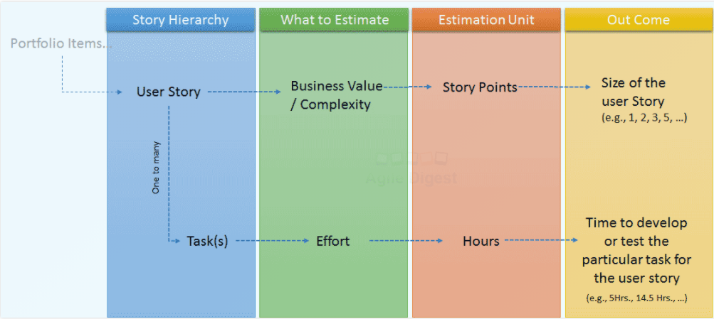
How to Estimate with Story Points in Agile
Step1: Identify a Base Story
Story Points in agile are a complex unit that includes three elements: risk, complexity and repetition.

Slide 9
Poker Estimation For Sprint Planning
Step 1: The Product Owner provides a short overview. The team is given an opportunity to ask questions. Product Owner describes his requirements and what is the desired functionality regarding the item that will be estimated. If there will be any questions from the Development Team or if there are any unclear points about the item, these are answered and clarified by the Product Owner to ensure healthy estimation.
After the Product Owner described the item and cleared out the questions, each individual lays a card face down representing their estimate. Based on the explained item, each Development Team members makes an estimate, chooses the card that represents his estimate. But not shows it immediately.
After each Development Team member finishes his estimates everyone calls their cards simultaneously by turning them over. This is done to prevent the Development Team members to affect each other’s estimate.

Slide 10
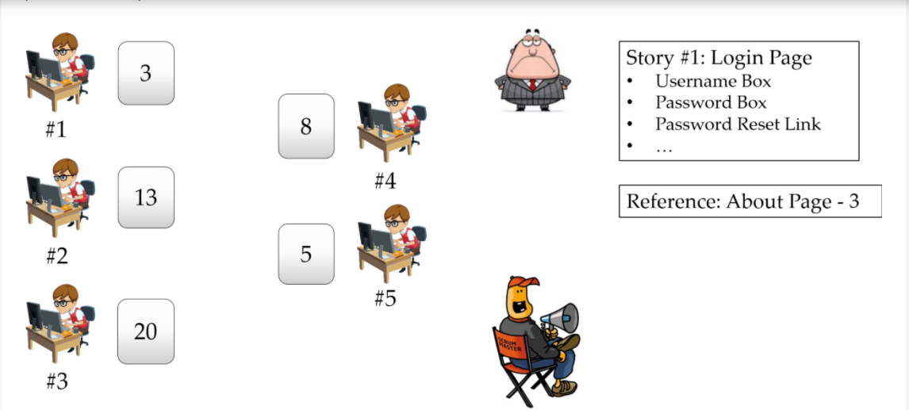
Poker Estimation For Sprint Planning

Slide 11
Poker Estimation For Sprint Planning
Step 2: After the estimations are presented, people with high estimates and low estimates are given a soap box to offer their justification for their estimate and then discussion continues. Because, if there is a big gap in estimation, then either the item needs to be clarified more or the development team members approach the task from different perspectives. In either case, situation must be clarified, and estimations must be closer.
Estimation process is repeated for the item, until a reasonable consensus is reached. Here consensus means, majority of the team will estimate the same card, and other developers should not deviate too much from the estimation of the majority.
As you see, for this Scrum Planning Poker, Developer 1 estimates "3", Developer 2 estimates "13", Developer 3 estimates "20", Developer 4 estimates "8" and Developer 5 estimates "5". There is a big divergence here. Especially Developer 1 and Developer 3 estimated the lowest and highest values respectively. They need to discuss what they considered about the story and justify their estimation during discussion.

Slide 12
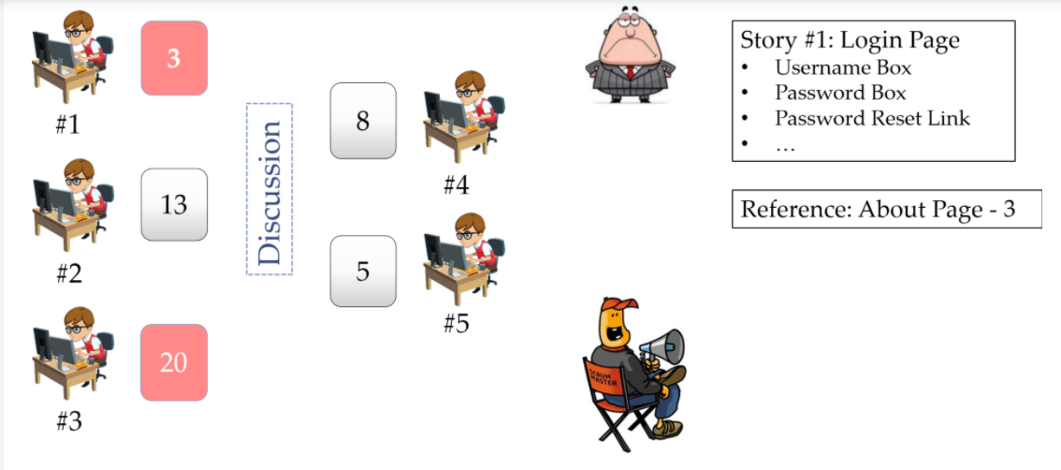
Poker Estimation For Sprint Planning

Slide 13
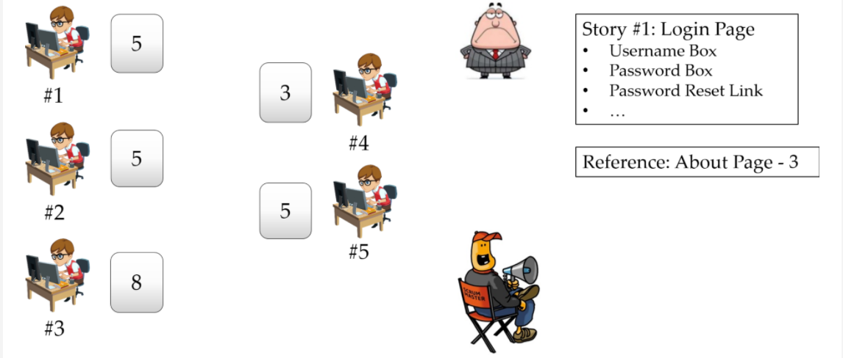
Poker Estimation For Sprint Planning
Step 3: During discussion, Developer 1 realizes that he missed a part of the task that needs to be developed. And Developer 3 understands that with the help of an existing design, story can require less effort. Discussion must end in 3minutes. and another estimation is done by the developers for the same story.

Slide 14
Poker Estimation For Sprint Planning
Step 4: As you see, three of the developers estimated "5", one developer estimated "3" and one developer estimated "8". But this is more convergent estimation compared to first estimation and majority of the developers estimated the story as "5". So, this story is estimated as "5" and planned in the sprint and estimation process starts again for the next story.

Slide 15
What are the benefits of User Story Points
Quickly estimate issues. Estimation is relative to already completed Product Backlog Items. This is faster than estimating without any reference.
Estimate without giving a specific time commitment. When estimating in hours, you make a precise time commitment. Estimating in Story Points prevents giving an exact commitment. Nobody knows exactly how many hours you are appointing to a specific issue.
Embrace the uncertainty that comes with estimation. Story Points specify an unknown time range. Selecting from a specific Fibonacci-like sequence of Story Points allows us to capture uncertainty.
Accurate enough to plan Sprints ahead. This allows us to better manage the time expectations of stakeholders for future work.
.

Slide 16
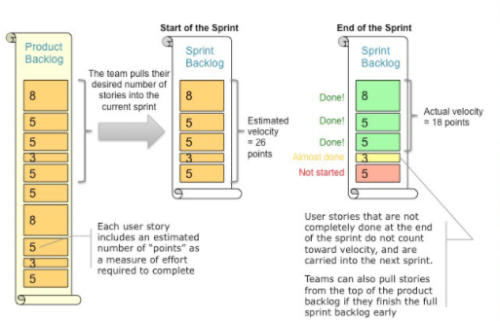
Velocity is the key Metric in Scrum

Slide 17
Velocity
There are certain questions that usually surface in almost every project regardless of the type, domain considered, technology used, complexities associated, or strategic significance. These questions are:
When will the project be completed?
What are the items you can deliver by the end of the project?
What are the items the team can take for the forthcoming release or iteration?
These questions fundamentally boil-down to the schedule of the project, and what and when the team can deliver over this schedule. As you can see, the first question is about the duration of the project, the next is about scope, and the final one asks about plans to be delivered.
.

Slide 18
Velocity
In Agile approaches, the concept of velocity helps to address such questions.
Basics of Velocity
Velocity is the measure of product backlog items (PBI) delivered in an iteration. It’s the rate at which the PBIs are delivered, validated, and accepted according to the definition of “done,” per iteration. In other words, you can say that velocity is a measure of a team’s rate of progress. You sum up the PBIs delivered and you get velocity. If the item is not completed, it won’t count toward velocity.
The PBIs in a backlog can be features, bugs, enhancements, spikes, and refactoring, among others. You may consider all of these as part of velocity or decide to include some. Irrespective of the decision you make along with your team, it’s important to always maintain transparency on this topic.
.

Slide 19
Velocity
In Agile software development, velocity is the amount of work a team can handle in a set period of time (sprint).
Managers use velocity to measure the rate at which an Agile development team delivers value to a business. For example, Scrum velocity will help you determine how quickly a Scrum team can complete the work assigned to them.
Velocity is used for measuring the rate at which scrum development teams consistently deliver business value in other words quantity of work a team can accomplish with in a sprint. It can be measured in terms of the of Story Points, days, ideal days, or hours a team can deliver per sprint of a given length, and with a predefined Definition of Done (DoD). Velocity helps a Team to forecast how many Sprints they need to develop new features.
Velocity is the rate at which the Resources completes works

Slide 20
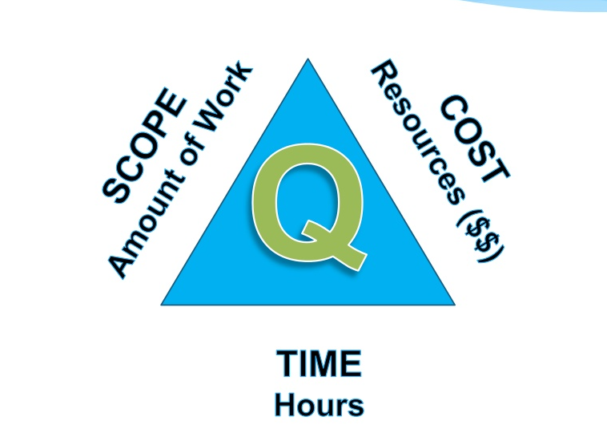
Project Triangle

Slide 21
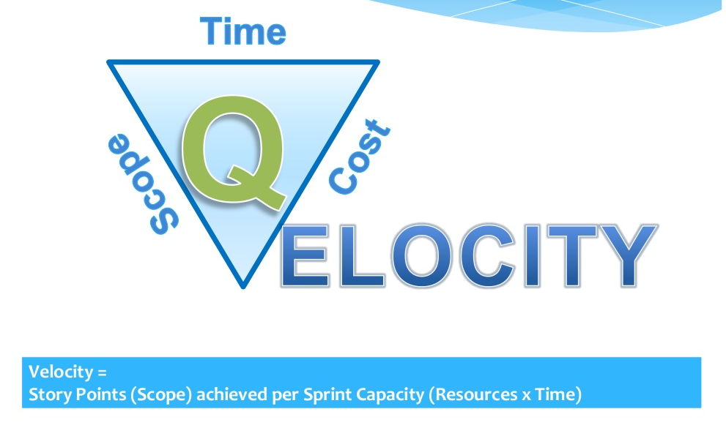
Agile Velocity Triangle

Slide 22
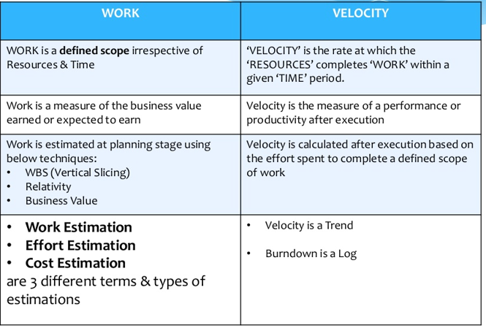
Work Vs. Velocity

Slide 23
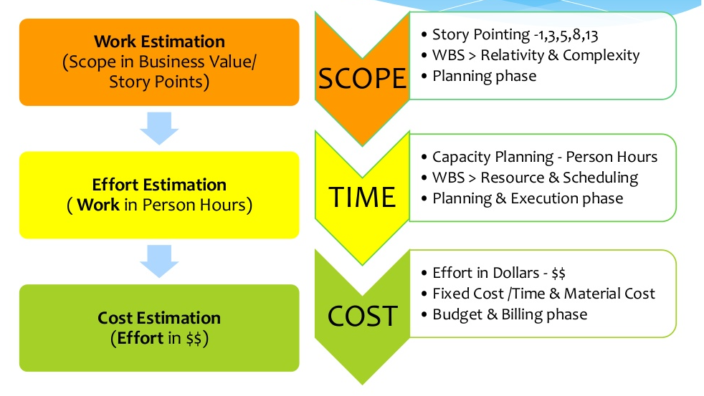
Estimation in Agile

Slide 24
Example - Velocity
Let’s say that in an iteration, your team delivered PBI-10, PBI-11, and PBI-3, which are estimated at 3, 8, and 5 story points, respectively. Velocity for the iteration would be 16 or 16 story points, as calculated below.
Velocity = Estimate for PBI10 + Estimate for PBI11 + Estimate for PBI3
Velocity = 16 (or 16 story points)
If you have an incomplete item, it won’t be considered for velocity calculation. For example, if PBI-11 remains incomplete at the of the iteration, the velocity will be 8 or 8 story points.
So, how does velocity help in answering the questions raised earlier, those of when the project will be complete and what items can be delivered?
Going back to our example, let’s assume the product backlog has 200 points worth of work, your velocity is 20 points per iteration, and each iteration has two-weeks duration.
Number of iterations needed = 200 / 20=10

Slide 25
Velocity in Ranges and Confidence Level
It’s possible that velocity can fluctuate for a team over the duration of a project or release. Considering our previous example, it can be as low as 15 (minimum) or as high as 25 (maximum).
No one exactly knows what the future entails. There can be inclusion of new high priority items, a change in a 3rd party component which introduces a number of bugs, or changes in team members for the project, etc. Hence, it’s a good practice to calculate the velocity range, in place of thinking of it in absolute numbers. For example, you can say that the team’s velocity range is between 15 to 25 story points. With this approach, you are conveying that it’s an estimation and nothing is absolutely certain.
Next, let’s see how the duration changes with range in velocity numbers. With a velocity of 15, you will be needing around 14 iterations to complete (200 divided by 15 and rounded it to 14) the backlog items, whereas with a velocity of 25, the team will be needing just 8 iterations to complete the project (200 divided by 25).

Slide 26
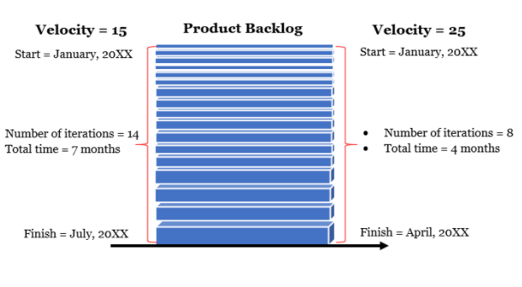
Velocity in Ranges and Confidence Level
Our velocity estimation can be refined further by looking at confidence intervals. For example, you can say the team can complete the initial 80 points with 90% confidence, whereas the next 70 points worth of work can be done with 50% confidence, and finally, the last 50 points worth of work with 10% or with very little confidence.

Slide 27
How To Scale Or Stabilize Team Velocity
Clear User Stories: User Stories are meant to be simple to read: giving more clear information on user requirement and providing sufficient information on the business case. The reason the Agile world encourages User Stories with a specific format is because the format is meant to be easy to read and simple to understand, both for the development team and other stakeholders. We must keep that in mind and encourage it in developing more meaningful User Stories that provide more granular detailed information. If the User Stories are clear and easy to assess story points or estimate time, then it becomes much easier to the development team to come up with accurate story points. If the story points are accurate and precise, then the development team can reach their goals in the assessed time. This indirectly helps to have stabilized and predictable team velocity.
Define Team Roles And Avoid Changes In The Team: Your team should have a clear definition of their roles on the given tasks or backlogs. Make sure that there are as few changes in the team as possible. "Keep teams stable and avoid shuffling people around between teams. Stable teams tend to get to know their capacity, which makes it possible for the business to have some predictability."

Slide 28
How To Scale Or Stabilize Team Velocity
Stick to the Daily Scrum: Maximize performance by calibrating daily. This optimizes team collaboration and performance by inspecting the work since the last Daily Scrum and forecasting upcoming Sprint work. The intention of the Daily Standup is to ensure that the team is coordinated and that anything distracting the team from accomplishing their goal is addressed
Clear Sprint Goal and "Ready State": "Ready are you? What know you of ready?"
Great performance first needs great preparation. Therefore, teams should invest in being "ready" before they start their work. In Agile, this is demonstrated through the Sprint Goal and the Product Backlog.
No telling people what to do - self organize! Agile itself is driven by certain parameters such as prioritized backlogs and limiting work-in-progress. Due to the framework itself, having the team self-organize around the work helps the team become hyper-productive. The best teams in the world, whether its the Navy Seals or a World Cup team, self-organize to achieve their team goal.

Slide 29
How To Scale Or Stabilize Team Velocity
Take Advantage Of Retrospective: Every retrospective is a chance to learn. Your team needs to use the opportunity to grow and improve. They need to be able to understand the situation they are in.
Eliminate Dependencies: Dependencies always delay the work of the team. I suggest to first start looking for dependencies in the User Stories. These help us know the internal and external dependencies. It’s best to select the stories where your team is most comfortable—whether in handling them together or one at a time. Also, look at the big picture and see if any other external dependencies will affect the sprint.
Automation/Process: Automating QA helps improve the validation process of the developed product. In the same way, we can extend the automation process to build procedures. These steps help in reducing the known and unknown issues, as well as help to improve the development process, thus helping to scale or stabilize the velocity.

Slide 30
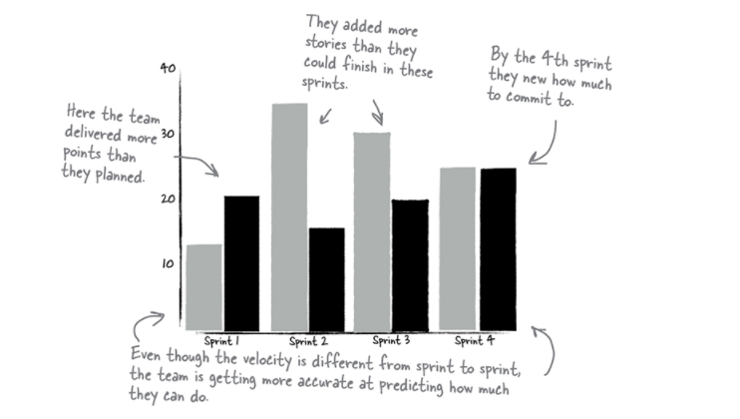
How To Scale Or Stabilize Team Velocity

Slide 31
Thank You

